Slide 1

Testing and Verification (CSC7056/CSC3056)
Aidan McGowan
Test Design Techniques

Slide 2
Test Design techniques
Test design is the act of creating and writing test cases and suites for testing software.
Test analysis and identifying test conditions gives us a generic idea for testing which covers quite a large range of possibilities
When we come to make a test case we need to be very specific.
Test cases can be documented as described in the IEEE 829 Standard for Test Documentation.

Slide 3
Did it do what it was supposed to do ?
A test should check that the system does what it is supposed to do.
Copeland says ‘At its core, testing is the process of comparing “what is” with “what ought to be” ‘. [Copeland, 2003].
If we simply put in some inputs and the system appears to work, because it didn’t crash, are we actually testing it?
You have observed that the system does what the system does - but this is not a test. Boris Beizer refers to this as ‘kiddie testing’ [Beizer, 1990]

Slide 4
Oracle
In order to know what the system should do, we need to have a source of information about the correct behaviour of the system – this is called an ‘oracle’ or a test oracle.
Once a given input value has been chosen, the tester needs to determine what the expected result of entering that input would be and document it as part of the test case.
Oracle: A source to determine expected results to compare with the actual result of the
software under test. An oracle may be the existing system (for a benchmark), other
software, a user manual, or an individual’s specialised knowledge, but should not be the
code.

Slide 5
Expected results
Expected results include information displayed on a screen in response to an input.
Decide on the expected results before running a test.

Slide 6
Expected results
E.g. small differences in calculations. Used for single bank transactions probably not significant but with yearly interest for many accounts would be very significant.
However, we would probably not notice small differences in calculations, or results that seemed to look OK.
So we would conclude that the test had passed, when in fact the software has not given the correct result.
Hence, ideally expected results should be predicted before the test is run.

Slide 7
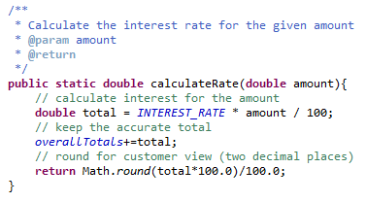



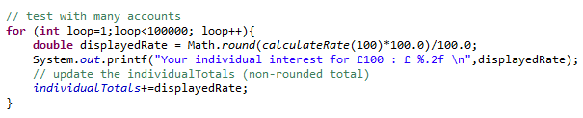

Interest Rate - Test

Slide 8
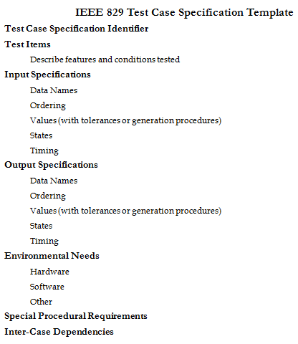
Test Case Design Spec

Slide 9


Purpose of Test Design techniques
To identify Test Cases and Test Data.
Classically these techniques fall into White Box and Black Box Testing.
Some techniques are in both….
Black Box or
Specification Based Test Design Techniques
White Box or
Structure Based
Test Design Techniques

Slide 10

Black Box (Spec Based) techniques
Black Box or
Specification Based Test Design Techniques
A way to derive and select test cases or test data based on an analysis of the test basis documentation.
Includes functional and non-functional testing.
Does not use an internal information of components or systems.
Includes the use of Modelling.

Slide 11

Black Box (Spec Based) techniques
White Box or
Structure Based
Test Design Techniques
Based on an analysis of the structure of a component or system.
Common characteristics :
  Information about how the software is constructed
  The extent of coverage of the tests (may be used then create more tests)

Slide 12
Experienced Based Design Techniques
Knowledge and experience of people are used to derive the test cases.
Also a Black Box Technique
Common characteristics :
  Knowledge of likely defects and their distribution
  Knowledge of software, it’s usage and environment by the users, developers, business analysts and testers.
  Knowledge from experienced testers.

Slide 13
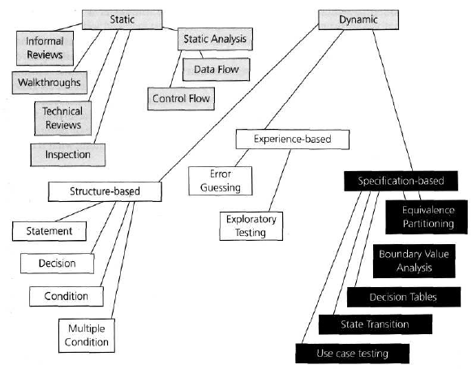
Testing Techniques

Slide 14
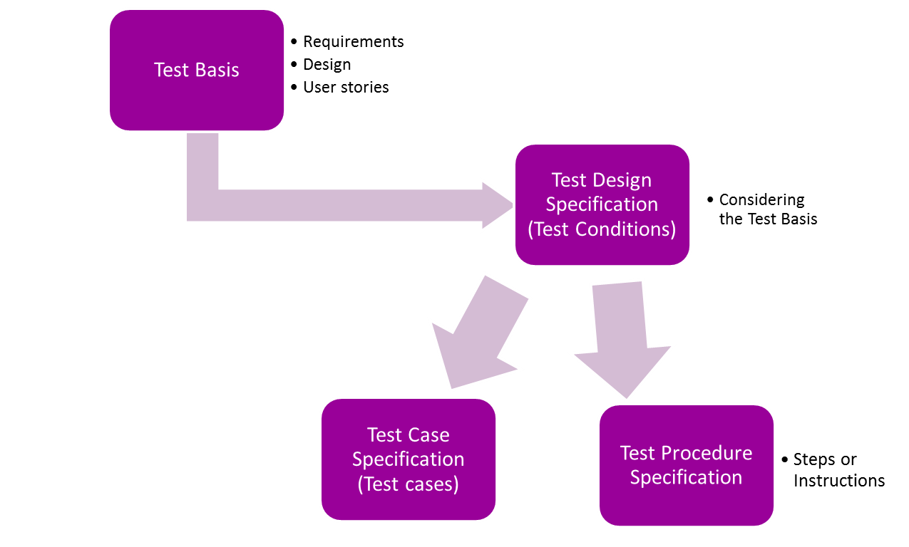
Creating a Test
Test Analysis
Test Design
Test Implementation

